Slide 1

Sentiment Analysis of Twitter Data
FR
FABRIKAM RESIDENCES
CIS 5367 Machine Learning
Group Members:
David Kurtenbach
Ayodamloa Olanipekun
Seth Paniagua
Cuong Phan
Folusayo Togun

Slide 2

Project Description
Sentiment Analysis of Twitter Data
Develop and implement a machine learning sentiment analysis model
Analyze Twitter data of large fashion brands
Train/test model
Inform marketing efforts in the fashion industry

Slide 3
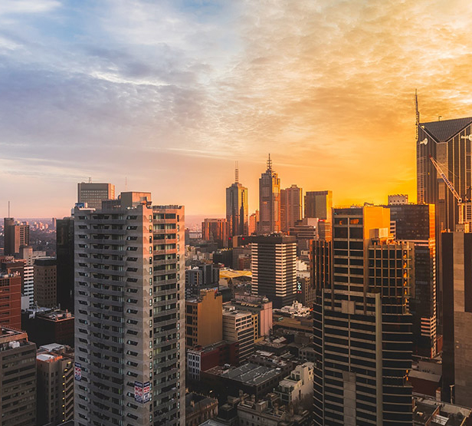
Business Case
Targeted Marketing
Local fashion startup company of >75 employees
Sell fast fashion and looking to improve targeted marketing for upcoming quarter
Analysis of 8 large fashion company Twitter feeds to identify trends and inform marketing campaign

Slide 4
Data Description
Sample and Timeframe
Data Details
Fashion Companies
Sample tweets of 8 large fashion companies
Date Range:
2020-03-01 to Present
Sample Size:
Index of 1,500 values
Fashion Nova - @FashionNova
Nike - @Nike
Victoria's Secret - @VictoriasSecret
Urban Outfitters - @UrbanOutfitters
Guess - @GUESS
Gucci - @gucci
Louis Vuitton - @LouisVuitton
Mango - @Mango

Slide 5



Data Source
Accessing Twitter Data
Publicly accessible information
Twitter data imported using an API
Limited to specific twitter handles

Slide 6
Data Preparation
Cleaning Dataset
TEXT

Slide 7
Data Analysis
TEXT

Slide 8
Findings & Results
TEXT

Slide 9
Business Impacts
TEXT

Slide 10
Challenges
TEXT

Slide 11
Thank you

